Slide 1
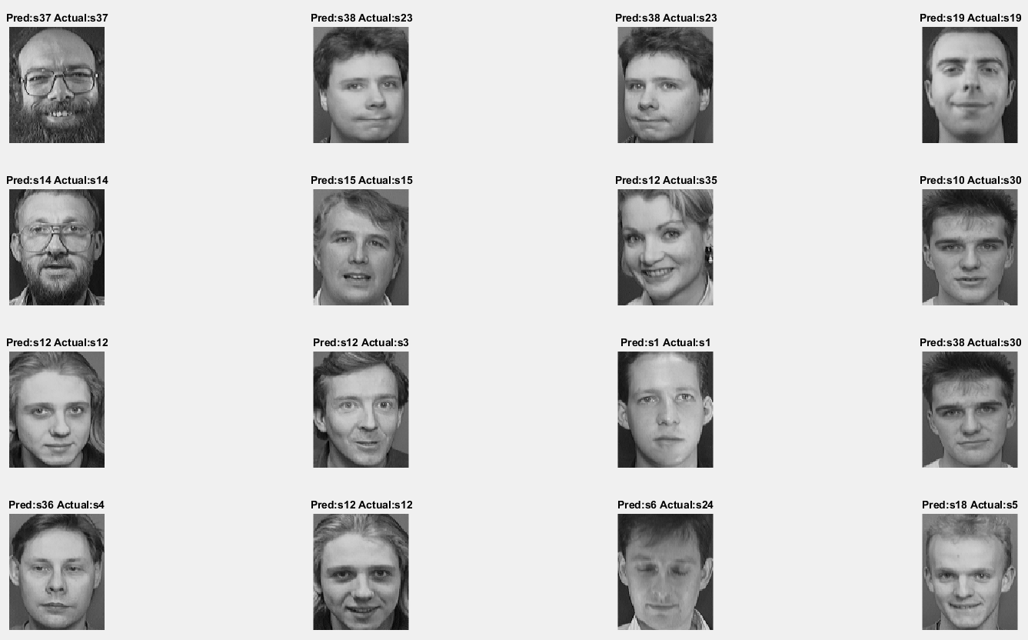

Final project
Genuine and impostor image detection
using Transfer learning
Shubhabrata Mukherjee
Graduate section

Slide 2
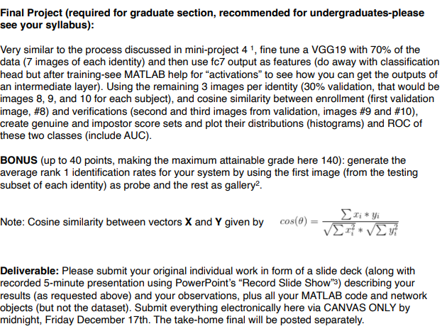
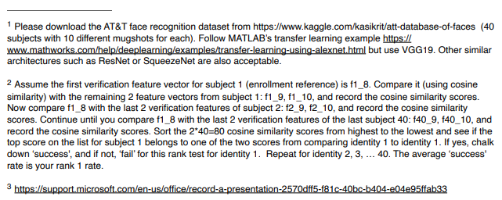
Questions and deliverables descriptions

Slide 3
Dataset descriptions
This dataset is called “Database of Faces”, which contains a set of face images taken between April 1992 and April 1994 at AT&T Laboratories, Cambridge [1].
The database was used for a face recognition project carried out with the Speech, Vision and Robotics Group of the Cambridge University Engineering Department.
There are ten different images of each of 40 distinct subjects. For some subjects, the images were taken at different times, varying the lighting, facial expressions (open / closed eyes, smiling / not smiling) and facial details (glasses / no glasses).
All the images were taken against a dark homogeneous background with the subjects in an upright, frontal position (with tolerance for some side movement). A preview image of the Database of Faces is available.
The files are in PGM format. The size of each image is 92x112 pixels, with 256 grey levels per pixel.
The images are organized in 40 directories (one for each subject), which have names of the form sX, where X indicates the subject number (between 1 and 40). In each of these directories, there are ten different images of that subject, which have names of the form Y.pgm, where Y is the image number for that subject (between 1 and 10).
1
2
3
8
9
10
4
5
6
8
9
10
8
9
10

Slide 4
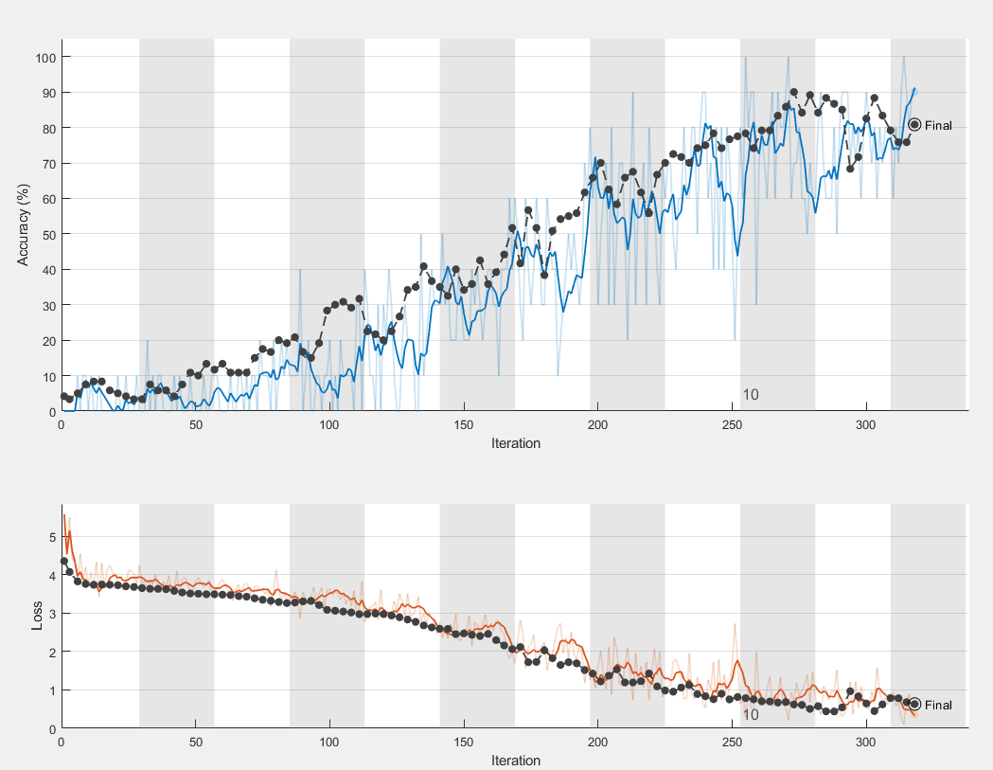
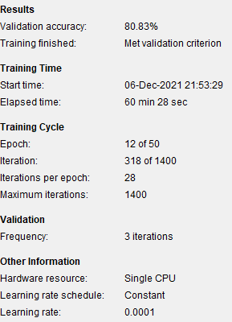
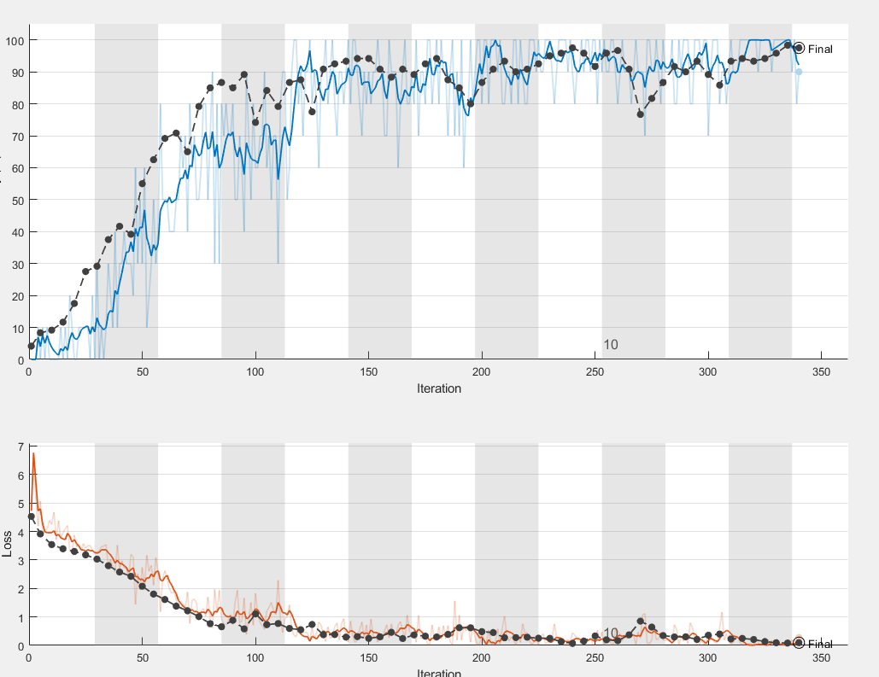
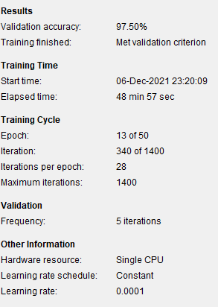
Pre-trained model preparation
The pre-trained vgg-19 model has been retrained in 2 stages using transfer learning.
In first stage of training vgg-19 retrained using face database training set and a validation accuracy of 80.83% was achieved.
In second stage of the generated vgg-19 using face database retrained and a validation accuracy of 97.5% was achieved.
This output of fc7 layer rom the final model of 97.5% accuracy was used to solve the problem in the final project.

Slide 5
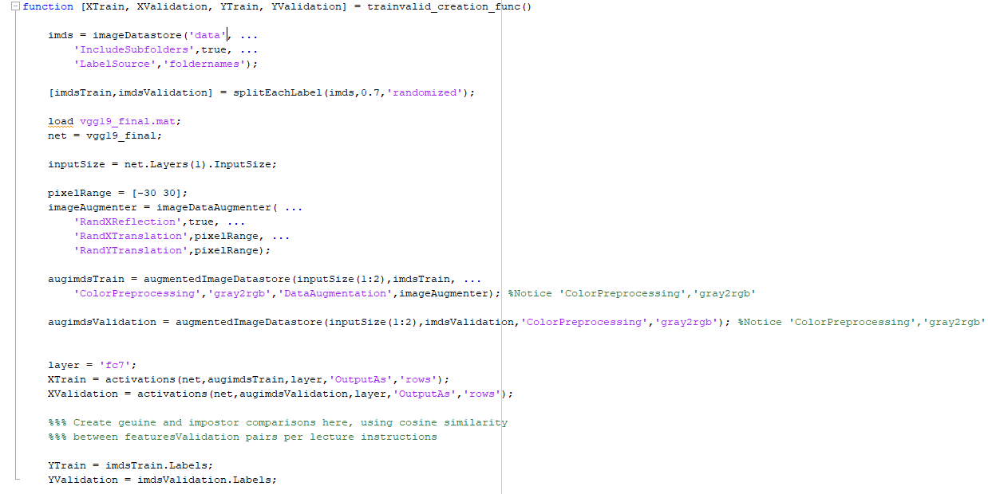
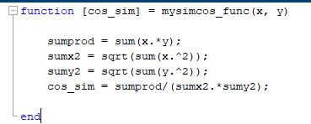
Methodology and function descriptions: part 1
mysimcos_func.m : This function is developed to calculate the cosine score between two vectors.
trainvalid_creation_func.m : This function is developed to calculate the train or validation for features and target.

Slide 6
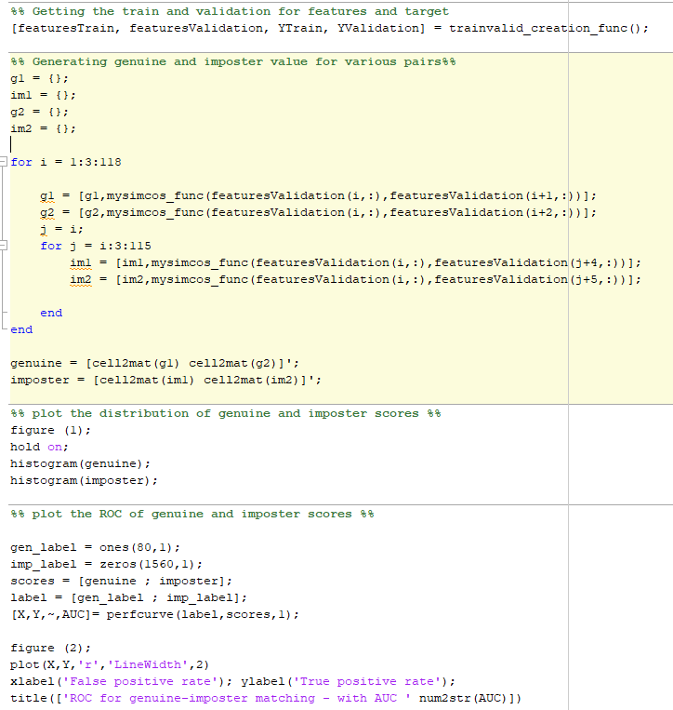
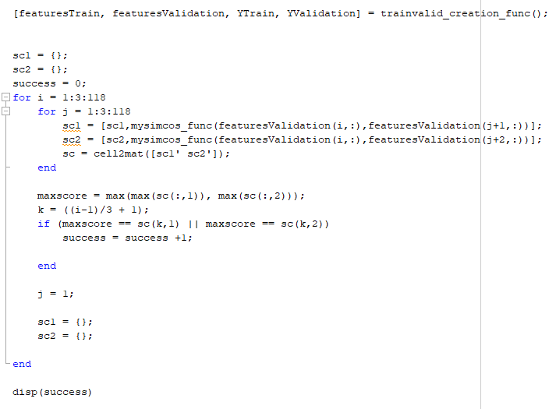
Methodology and function descriptions: part 2
Final_project_extension.m: This is the main matlab code file to calculate the average rank1 identification rate.
Final_project.m : This is the main matlab code file to calculate the genuine/imposter distribution and plotting ROC.

Slide 7
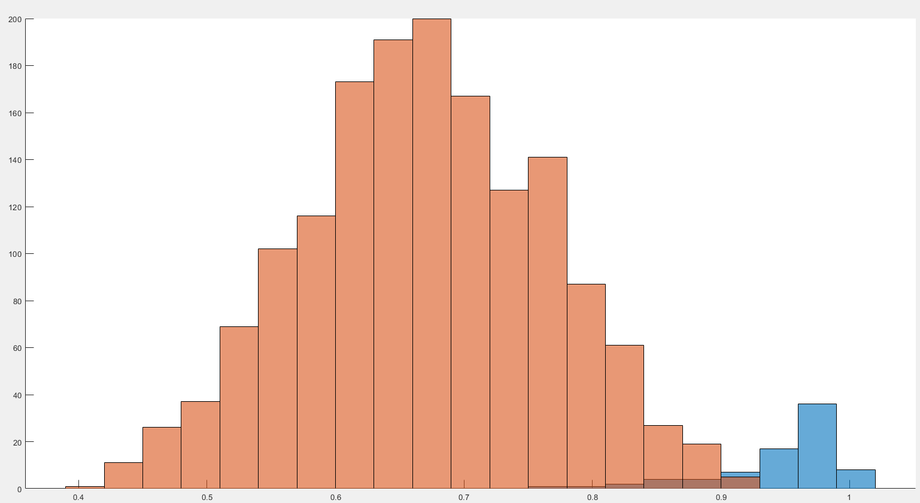
Result and analysis : Distribution
In above figure the distributions of the calculated genuine and impostor score sets has been plot using a histogram.
As seen, the number of genuine scores (in blue) are only 80 but the number of impostor scores (in orange) are 1560, the loose threshold between genuine and impostor score is around .8 to .9

Slide 8
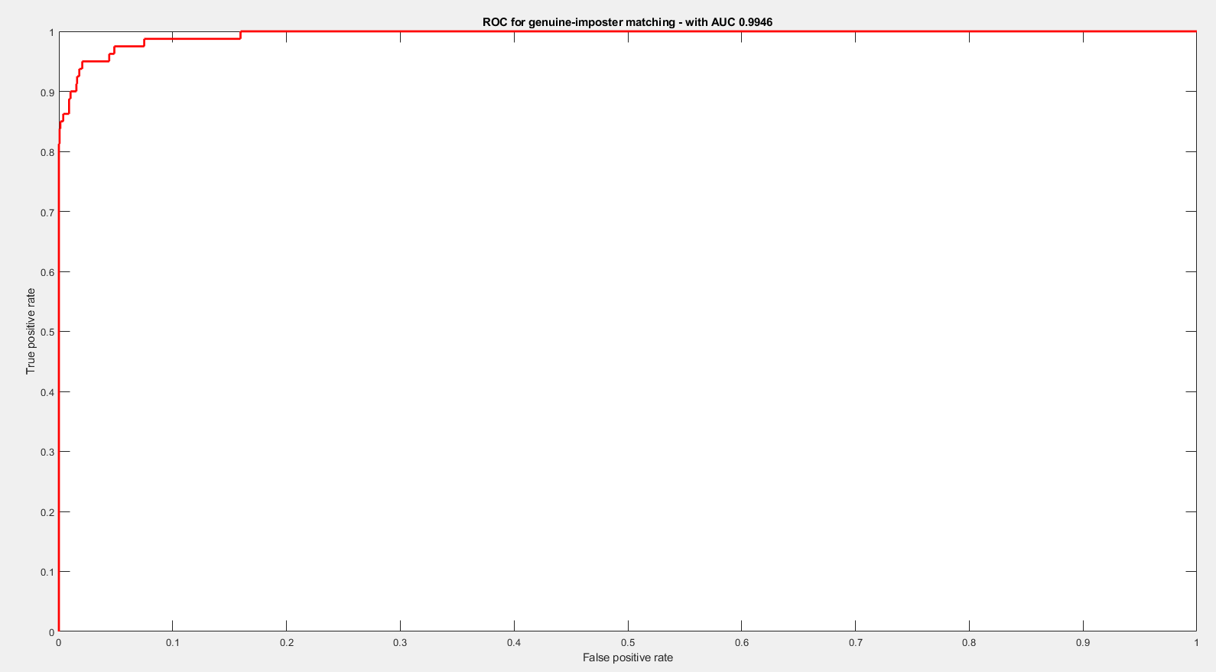
Result and analysis : ROC
In above figure the calculated genuine and impostor score sets has been plot using a ROC plot.
As seen, the vgg19 which was trained on face dataset using transfer learning performed well for this problem with .9946 AUC value.

Slide 9
Conclusion and discussion
In first part of the project, we took a pre-trained vgg_19 model and used it’s fc7 lower to achieve the impostor detection.
From the distribution of scores, it was observed that, the threshold for genuine and impostor class is around .8
From the ROC plot, it was observed that, the AUC of the ROC plot for these two classes is .9946
Both the point (1) and (2) reinforces the conclusion that, this classifier could classify genuine and impostor classes very well.
In second part of the project, we took the same classifier to achieve the rank1 identification rate.
The rank 1 score obtained is 100%.
So, point (1) gives the conclusion that, this classifier could perform rank1 identification very well.

Slide 10
References
[1] Copyright © 2002 AT&T Laboratories Cambridge: https://www.cl.cam.ac.uk/research/dtg/attarchive/facedatabase.html
[2] S. Liao, Zhen Lei, Dong Yi and S. Z. Li, "A benchmark study of large-scale unconstrained face recognition," IEEE International Joint Conference on Biometrics, 2014, pp. 1-8, doi: 10.1109/BTAS.2014.6996301.

